Slide 1
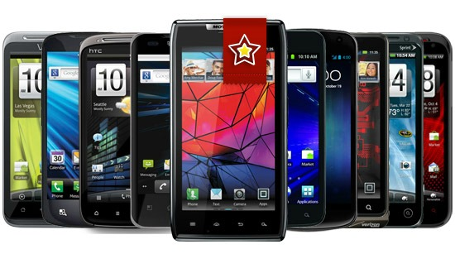
Mobile Terminology Basics
Created by Ivette Doss

Slide 2
Why you need this?
This Presentation is part of liveable QA Student Social Network established by Mikhail Portnov: Graduated Students shared their experiences with the current Students to help them successfully pass Internship or Job Interviews.
The objective is not overload you with the computing/software definitions but to prepare you to efficient understanding of the Interview Questions matter and the explanation of the Answers.
So, we need to learn Mobile Terminology Basics first.

Slide 3

interview Questions objectives:
Mobile OS/Platform Fundamental
How well you know Mobile Devices
Mobile/Software literacy
Specific of Mobile Testing
Mobile Testing tools
Security of Mobile Devices
The future Trends in Mobile World

Slide 4


Mobile OS/Platforms Fundamental

Slide 5
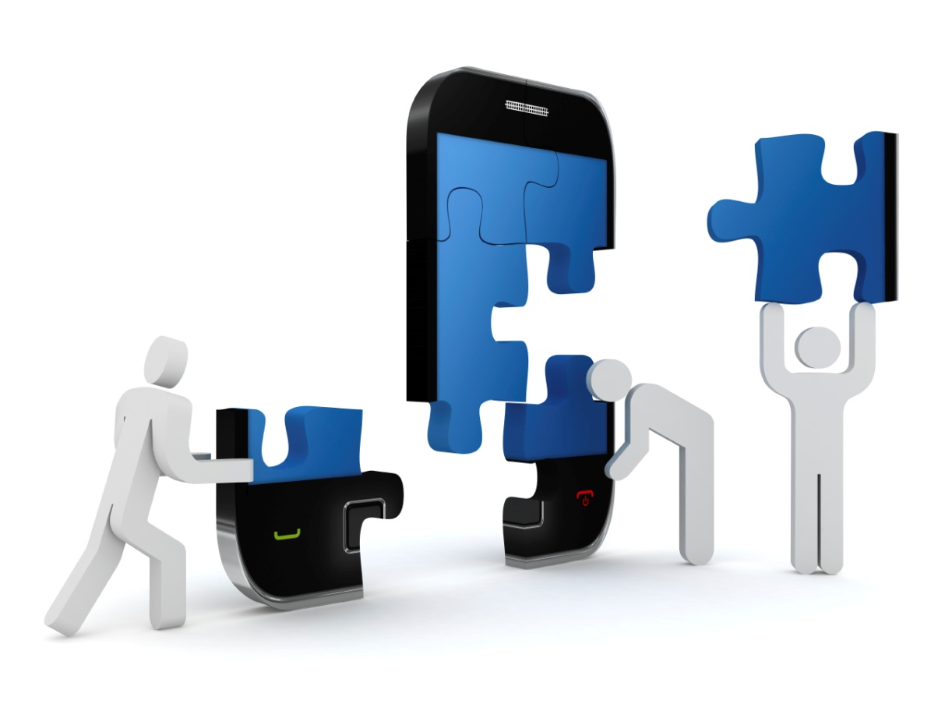
Clarify definition of Platform:
1. Platform as Conceptual Mobile Architecture.
2. Platform as an Operating System.
3. Platform as an Application Development base.
4. Platform as a kernel/platform, buffer and bridge between hardware and software
5. Platform as a core programming language in which all program for device are written

Slide 6

Clarify confusion: OS=Platform
The terms platform and operating system mean almost the same thing.
An operating system lets your computer run and control its most basic functions, but the platform is something, upon what programs/applications (like calendar or web browsers) can be installed and used.
Think of platform as a broader term denoting the difference between Mac and Windows in general, while operating system is more often used to when referring to specific versions of Windows or Mac.
http://www.pcmag.com/category2/0,2806,2362,00.asp

Slide 7
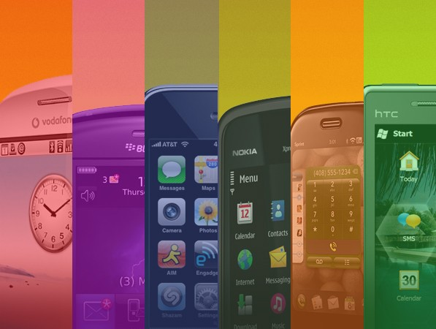
Types Mobile Platforms
Licensed
JME
BREW
Proprietary
OS X
Symbian (Eclipse Lic.)
Open Source
Android-OHA
LiMo
BBX
Windows Phone
bada
Maemo
MeeGo
webOS
Tizen
Linux
Alternative
A mobile platform’s primary duty is to provide access to the devices.
Like all software platforms, these are split into three categories: licensed, proprietary, and open source.

Slide 8


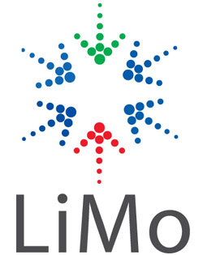
Platforms: Licensed
Following are the licensed platforms:
The major goal of Licensed Platforms was to create a common platform of Application Programming Interfaces (APIs) development that work similarly across multiple devices with the minimum effort required to adapt the device differences.
Licensed platforms are sold to device makers for non-exclusive distribution on devices.

Slide 9

Proprietary Platforms
GOOD
BAD
Simplified User Experience
Limited Customizability
User Multiplier Effect
Interoperability
Proprietary platforms are conceptualizes, designs, develops and sells by device-makers for use on their devices.
They are not available for use by competing device makers.
http://www.ehow.com/info_8366503_advantages-disadvantages-proprietary-operating-system.html

Slide 10

Open Source Platforms
Open source platforms are mobile platforms that practicing the main principle of Open-Source software development: peer production by bartering and collaboration with the end-product, source material, “blueprints”, and documentation available at no cost to the public.
They freely available for users to download, alter, or edit.
The major Open Source Platforms are Android, webOS, Tizen, Linux

Slide 11
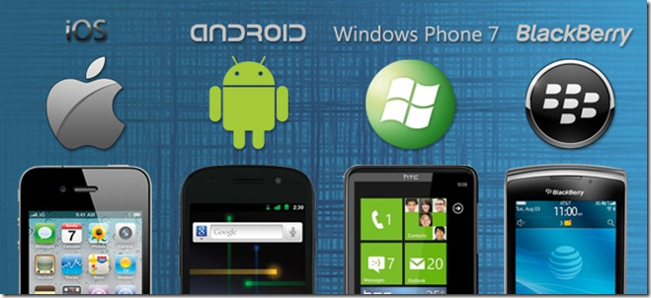
Mobile Operating System
Operating system (OS) could be considered as the heart of the computer.
It is the first software or set of programs, that runs on the computer when the system is turned on.
Operating system is a software that controls the hardware and its communication/utilization with the end user’s application/programs.
Some of the common actions that an operating system performs are: file management, memory allocation, input identification and output transmission.
http://buildacomputeronline.net/Operating-system.html

Slide 12
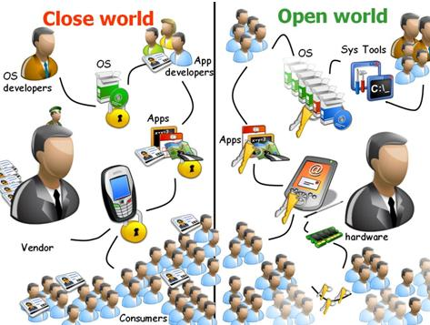
Open vs. Close Operating System
Proprietary - iOS
Open Source - Android

Slide 13
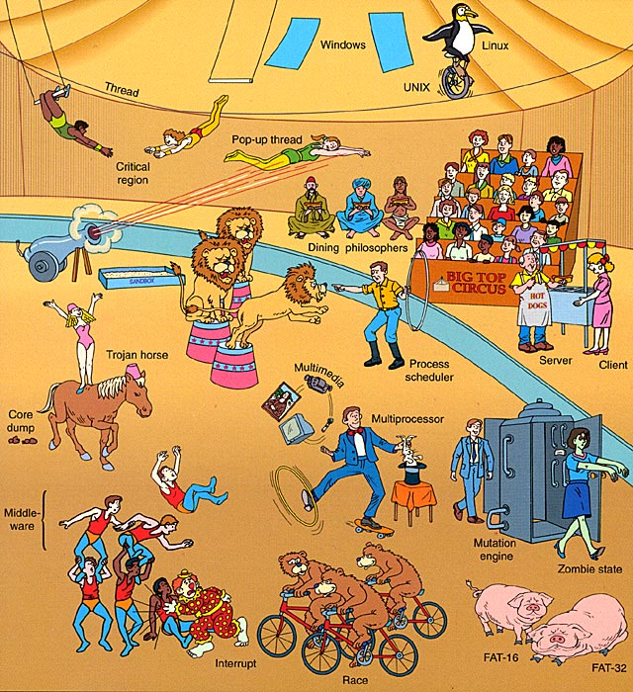
Types of Operating System
Different types of operating system exists based on the performance.
They are:
Realtime (RT),
Multiuser,
Multitasking,
Multithreading

Slide 14
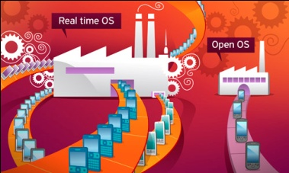
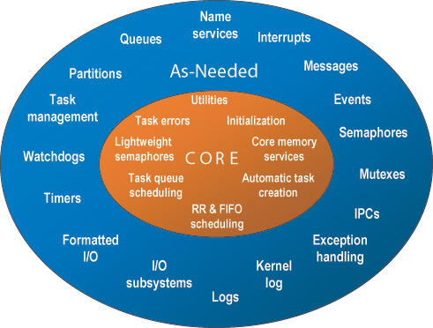
Types of Operating System
Real Time OS
Real time operating systems (RTOS) intended to serve real-time application requests.
Real-time computing (RTC) is the study of hardware and software systems that are subject to operational deadlines from event to system response. Real-time programs must guarantee response within strict time constraints.

Slide 15
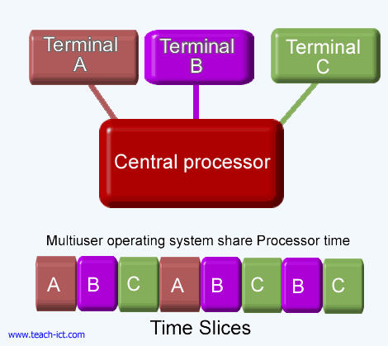
Types of Operating System
Multiuser operating systems, as the name indicates, allow multiple users to run programs concurrently on the computer.
Some multiuser operating systems allow only tens of users, whereas some other OS allows thousands of users to work at the same time, without compromising the performance. Multiple users do not mean that multiple accounts on the same computer, logging in at different times.

Slide 16
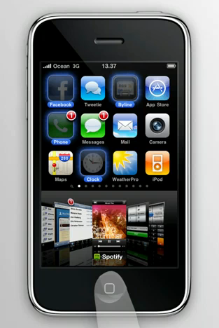
Types of Operating Systems
Multitasking operating systems allows multiple programs to run on the computer simultaneously. This increases the performance of the system.

Slide 17

Types of Operating Systems
Multithreading OS is even smarter, because it allows different parts of different programs to run concurrently, thus increasing the performance to a higher extend.

Slide 18
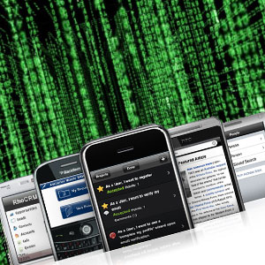
Framework, Kernel
A framework is a collection of pre-made tools and functions such as a code library, API, compilers, tool sets.
For example:
Platform: Windows CE; OS: Windows Phone; Framework: .NET
Platform: OS X; OS: iOS; Framework: Cocoa Touch
A kernel is the main component of most operating systems; it is a bridge between applications and the actual data processing done at the hardware level.
http://en.wikipedia.org/wiki/Kernel_(computing)

Slide 19



machine, source, and logic code
Source code is any collection of computer instructions written using some human-readable computer language (text).
The source code is automatically translated at some point to machine code that the computer can directly read and execute.
Logic code includes bytecode, source code, and machine code.
It actually means that execution of the program is not restricted by the type of operating system provided.

Slide 20


Operators-Carriers-Providers
We hate them, but Operators are what essentially make the entire mobile ecosystem work.
They install cellular towers, operate the cellular network, make services (such as the Internet) available for mobile subscribers, and they maintain relationships with the subscribers, handling billing and support, and offering subsidized device sales and a network of retail stores.
The operator’s role in Mobile World is to create and maintain a specific set of wireless services over a reliable cellular network.

Slide 21
Top Rank World and US Operators
Rank | Operator | Market | Technology | Users Q4 2011 –Q1 2012 (in millions)
1 | China Mobile | China, Hong Kong, Pakistan | GSM, GPRS, EDGE, TD-SCDMA | 667.20
2 | Vodafone | Europe, India, US, Africa, Australia | GSM, GPRS, EDGE, UMTS, HSDPA | 439.601
3 | Telenor | Europe, Russia, South-East Asia | GSM, GPRS, EDGE, UMTS, HSDPA | 326.0
4 | Airtel | India | GSM, GPRS, EDGE | 245.337
5 | America Movil | North and South America | CDMA, CDMA2000 1x, EV-DO, GSM, GPRS, EDGE, UMTS, HSDPA | 236.0
17 | T-Mobile | Europe, US | GSM, GPRS, EDGE, UMTS, HSDPA | 129.14
18 | Verizon Wireless | USA | CDMA2000 1x, EV-DO | 108.7
20 | AT&T | US, Puerto Rico | GSM, GPRS, EDGE, UMTS, HSDPA | 100.7

Slide 22
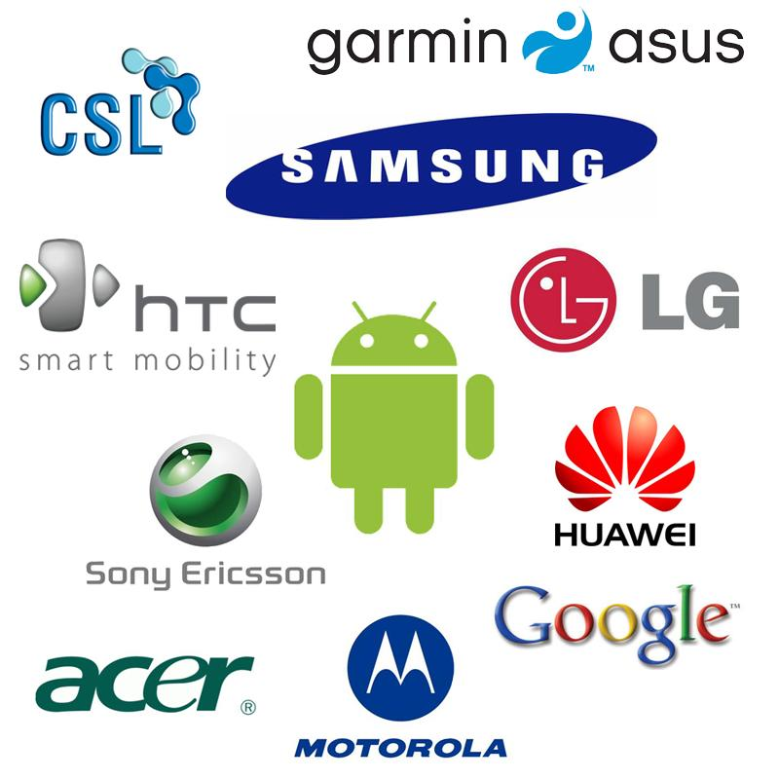
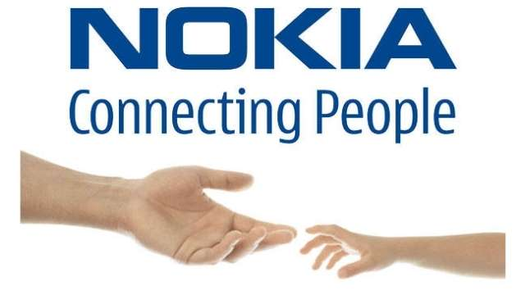

Mobile Phones makers/trends

Slide 23


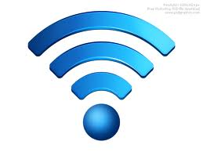
Network: Concept
The cellular technology is just a radio that receives a signal from an antenna.
The type of radio and antenna determines the capability of the network and the services you can enable on it.
The vast majority of networks around the world still use the GSM (Global System for Mobile Communications) and CDMA (Code Division Multiple Access)

Slide 24

Definition you should know:
Global System for Mobile Communication
AT&T and T-Mobile
Voice calling, text
messaging, data service
similar to CDMA
Visible feature – SIM card
that identify the user on the
network and could be use as
a storage. SIM cards allowed
Users switch phones by
simply moving their SIM’s
between the phones.
Advance (2.5-3G) techno-
logy refers to: GPRS, EDGE.
Standard speed 128 kb/s to max 480 kb/s
Code Division Multiple Access
Verizon and Sprint
Five times up of GSM
capacity. More secure –
used by military
QUALCOMM designs the
chips for the CDMA air
interface.
Advance technology refers to: WCDMA, FDMA, TDMA, CDPD.
Standard speed 500 kb/s to max 2.5 Mbit/s

Slide 25
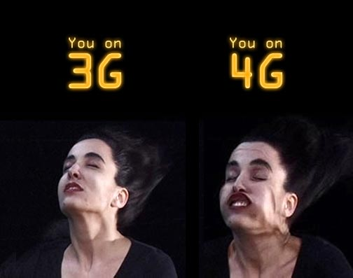
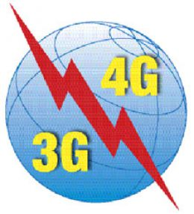
Mobile Network: 3G &4G
When we say 3G-4G, we often talking not about just the capabilities of the network, but about the devices that run on it.
3G-4G network generations are most often used to describe the data speeds or the rate of data transmission that the network is capable to deliver.
Types of 3G broadband include: Enhanced Data GSM Environment (EDGE), EV-DO, and High-Speed Downlink Packet Access (HSPA).
WiMax and LTE represent 4G broadband.

Slide 26
Connecting via Mobile Network
Technology | Abbreviation Meaning | Connection Speed
GPRS | General Packet Radio Service (2-3G GSM) | 128 kb/s
EDGE | Enhanced Data for GSM Evolution | Up to 476 kb/s
HSPA | High-Speed Packet Access | Up to 1 Mbit/s
3G | Third Generation | 384 kb/s to 2 Mbit/s
HSDPA (“3.5G”) | High-Speed Downlink Packet Access | 14.4Mbit/s
4G WiMax | Worldwide Interoperability for Microwave Access | 128Mbit/s
4G LTE | Long Term Evolution | 300Mbit/s to 1Gbit/s

Slide 27
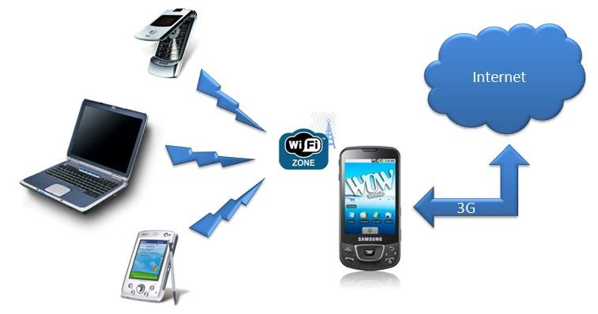
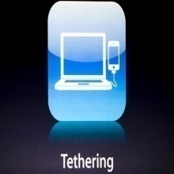
What is a Tethering?
Tethering is a way to share an Mobile phone cellular data connection with other nearby computers and wireless devices.
All data send to and from those devices is routed through the Mobile Phone.
Devices can connect to the Mobile Phone when it's in tethering mode in three different ways:
Wi-Fi, Bluetooth, USB
When tethering is enabled, the Mobile phone functions like a cellular modem or Wi-Fi hotspot, and broadcasts the Internet connection to devices it connected to.
http://tether.com/

Slide 28
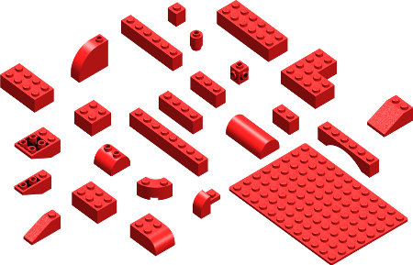
Markus Falk’s Mobile Framework chart
It is always good to know the cons and pros of tools Developers use to create a mobile software…
A frequently-updated chart by Markus Falk does this for the mobile frameworks as there is a detailed comparison of their capabilities.
The chart displays the rendering engines supported, target platform, hardware, development languages, UI features and license for each framework.
It also contains a wizard for project’s strict requirements that helps filtering the frameworks.
http://www.markus-falk.com/mobile-frameworks-comparison-chart/

Slide 29
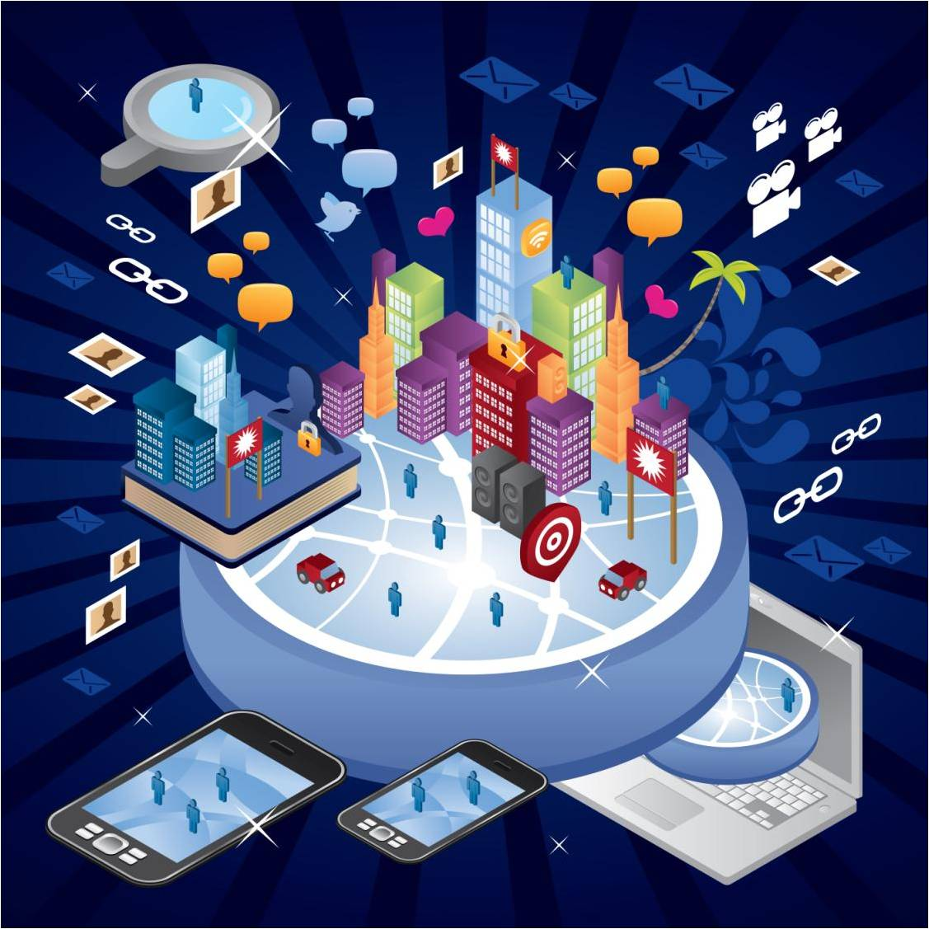
How well you know Mobile Devices

Slide 30

What is API?
An Application Programming interface (API) is a set of functions, classes, libraries, or packages (a.k.a. frameworks) that allowing the programmer to access an application’s services by using the programming languages.
An API may include specifications for routines, data structures, object classes, and variables.
An API specification can take many forms, including an International Standard such as POSIX or vendor documentation such as the Microsoft Windows API, or the libraries of a programming language such as Standard Template Library in C++ or Java API.

Slide 31



Application Framework:
An application framework is a software database that provides a fundamental structure to support the development of applications for a specific environment.
An application framework acts as the skeletal support to build an application.
Application frameworks are not a recently emerged idea. Some of the old application frameworks that are still used today are the SmallTalk user interface framework, MacApp (for Macintosh), and Struts (for Web-based Java applications).

Slide 32
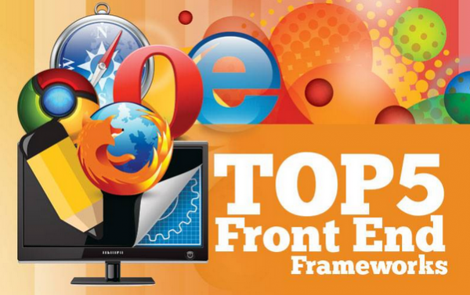
Top Apps Frameworks
jQTouch (Amazon, Mozilla, Google, Twitter, MS, Craiglist, WordPress)
Prototype (Apple, HubPages, AutoTrader, TicketMaster)
Struts (Yell, IRS, TelecomFrance, The ShoppingChannel, One Entry)
Bootstrap (NASA, Read.gov, InEx Finance, Syd PHP, PressAboutUs)
JavaScript MVC (T-Mobile, Grooveshark, Wegener, Mindjet, Kaplan)
http://www.sparkyhub.com/top-5-front-end-frameworks-infographic/

Slide 33
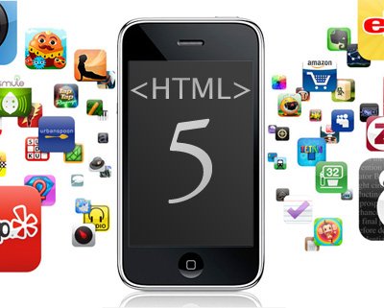
HTML5 – new and powerful
HTML5 is simply a new revision of an existing standard for delivering content on the World Wide Web (HTML stands for Hyper-Text Markup Language).
Before HTML5 we’ve been relying on plug-ins like Flash and Quicktime to evolve the web and enhance how we deliver content through the browser.
Now have the ability to play audio, watch videos, access local hardware on machines, and even play games all through nothing but a standard web browser using nothing but Javascript, CSS3, and a few new tags defined in the specification.
http://bostinno.com/all-series/html5-for-mobile-%E2%80%93-what-you-need-to-know-now/

Slide 34
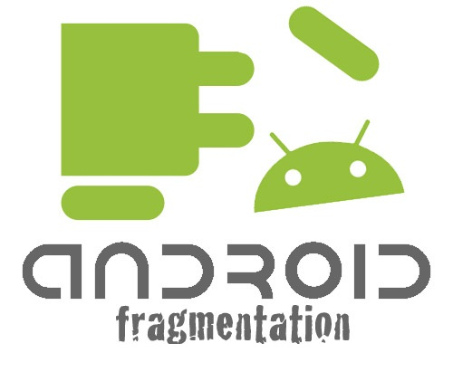
Definition you should know
Fragmentation is the inability to "write once and run anywhere".
More formally, it is the inability to develop an application against a reference operating context (OC) and achieve the intended behavior in all OCs suitable for the application.
Causes of fragmentation:
Hardware diversity
Software diversity:
Platform diversity
Implementation diversity
Feature variations
User-preference diversity
Environmental diversity
http://www.comp.nus.edu.sg/~damithch/df/device-fragmentation.htm

Slide 35
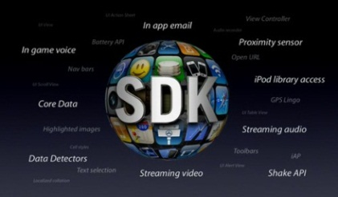
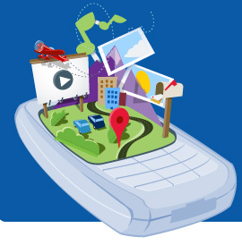
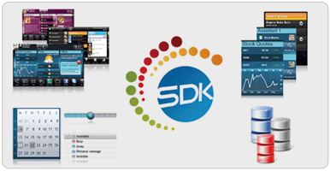
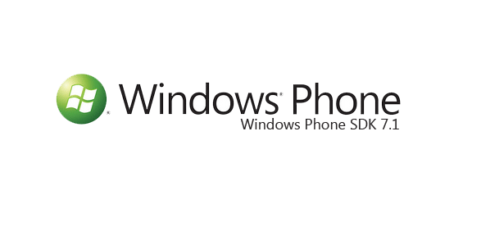
Term to know: SDK
Software Development Kit, a programming package that enables a programmer to develop applications for a specific platform. Typically an SDK includes one or more APIs, programming tools, and documentation.
iPhone SDK:
http://www.morgana.ca/freedev.html
Android SDK:
http://developer.android.com/training/basics/firstapp/index.html
Windows Phone SDK:
http://msdn.microsoft.com/en-us/library/ff402523(v=vs.92).aspx

Slide 36
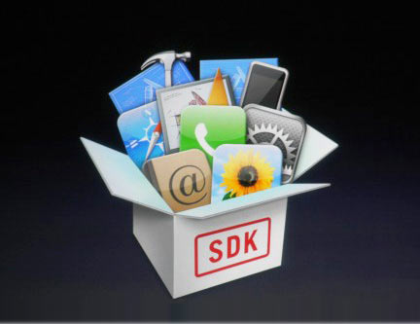
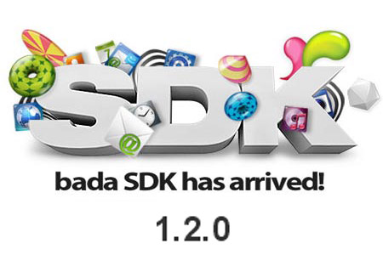


Interview Question: What is SDK?
A software development kit is typically a set of software development tools that allows the creation of applications for a certain software package, software framework, hardware platform, computer system, video game console, operating system, or similar platform.
It may be something as simple as an application programming interface (API) in the form of some files to interface to a particular programming language or include sophisticated hardware to communicate with a certain embedded system.
Common tools include debugging aids and other utilities often presented in an integrated development environment (IDE).
SDKs also frequently include sample code and supporting technical notes or other supporting documentation to help clarify points from the primary reference material.

Slide 37
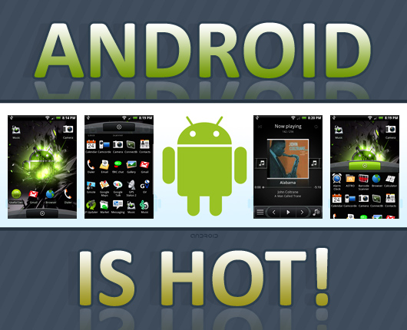
Rooted vs. un-rooted phone
Un-rooted phone will have pre-set OS configuration and you will be not able to change system settings.
Rooted phone means that you could install whatever your liked or change settings and configuration of your phone. Basically, rooted phone allows you to have administrator rights.
http://root-android.org/
http://www.theverge.com/2011/12/7/2585779/android-history

Slide 38

Locked vs. un-locked phone
Unlocked cell phones are mobile phones that can be used on any GSM network with interchangeable SIM cards.
No matter which carrier makes the card, the phone will be able to recognize it and send voice and data over the network.
This contrasts with a locked phone, which is bound to a specific cell phone service provider (or carrier) network with software settings, and is typically offered with a contract when someone starts mobile service.

Slide 39

Definition to know: Jailbreak
Jailbreaking is the process that modified iOS to run unsigned code in order to gain access to files that Apple wouldn’t normally let you access.
Jailbreaking adds unofficial application installers to your iOS device, which let you download many 3rd-party applications and extensions that are unavailable through the App Store.
You can install extensions that give you instant access to your system settings from anywhere on your iOS device, bypassing certain Apple restrictions or find packages that give you administrator control over your iOS or carrier experience.

Slide 40

Build Professional Language:
compile - Produce (something: list, file, application) by assembling information collected from other sources;
debug - Identify and remove errors from (computer hardware or software).
deploy - To bring (something: application) into action

